Slide 1
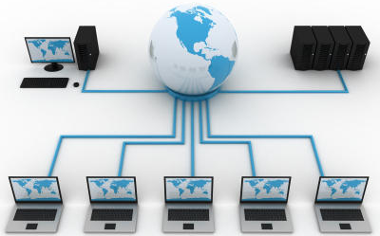
Wired Communication
By: Haron Abdel-Raziq

Slide 2
Schedule & Other Details
We noticed the struggle with Lab 2
Lab 2 is now due on October 5th
Milestone 2 is Due on October 12th
Next week (Monday) there is an FPGA lecture
Will be given by Professor Bruce Land
You should definitely attend

Slide 3
Wired Communication

Slide 4
Why Wired?
Wired connectivity is by far the most prevalent type of interconnection on chip
Important to understand how it functions if you intend on combining many chips together on a single board
Allows for a wide variety of interfaces
Reliable, fast, relatively straightforward to implement/understand

Slide 5
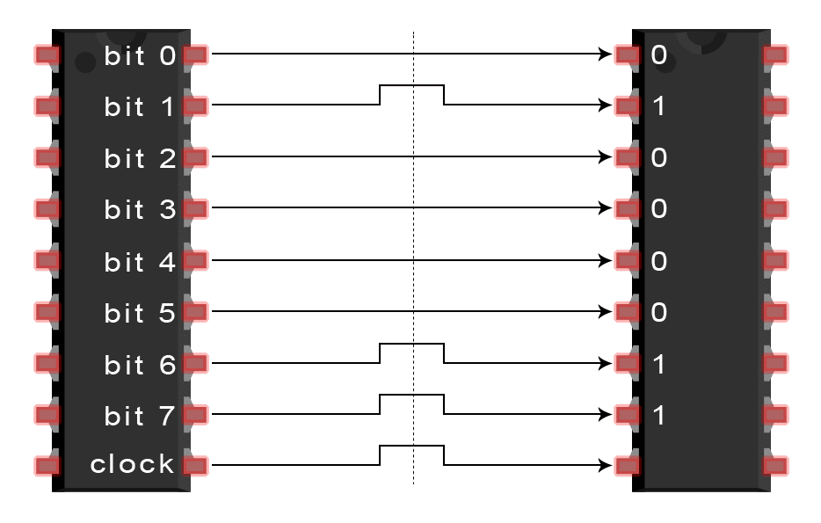
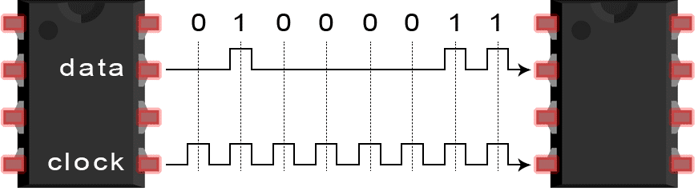
Parallel Vs. Serial
Sending Bit Pattern 01000011
Serial
Parallel

Slide 6
Parallel Vs. Serial
Parallel
Pros
Transmit data over multiple channels simultaneously
Cons
Must always be clocked
Requires more wires and pins
Crosstalk
Intersymbol Interference (ISI)
Serial
Pros
Simpler design (fewer wires and pins)
Can be clocked faster than parallel
Can be asynchronous
Cons
Sends a single stream of data
PCI: Max Parallel Speed: 4.266 Gbits/s, Max Serial Speed: 256 Gbits/s

Slide 7
Serial Communication
 | UART | SPI | I2C
Maximum Speed | 115200b/s | 10 Mbps | 5 Mbps
Synchronous/ Asynchronous | Asynchronous | Synchronous | Synchronous
# Of Wires | 2 | 4 | 2
Max # of Masters | 1 | 1 | Unlimited
Max # of Slaves | 1 | Unlimited* | 1008

Slide 8
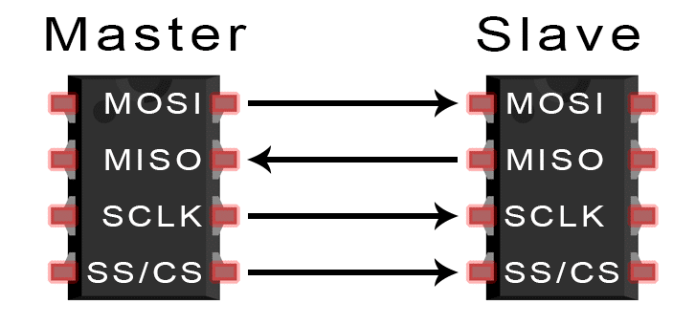
SPI (Serial Peripheral Interface)
Master sends data on MOSI line
Clocked by SCLK
One bit per clock cycle
Configurable clock
Multiple slaves controlled by SS/CS (active low)
Commonly used for: memory, memory cards, sensors, displays
MOSI = Master Out/Slave In
MISO = Master In/Slave Out
SCLK = Serial Clock
SS/CS = Slave/Chip Select

Slide 9
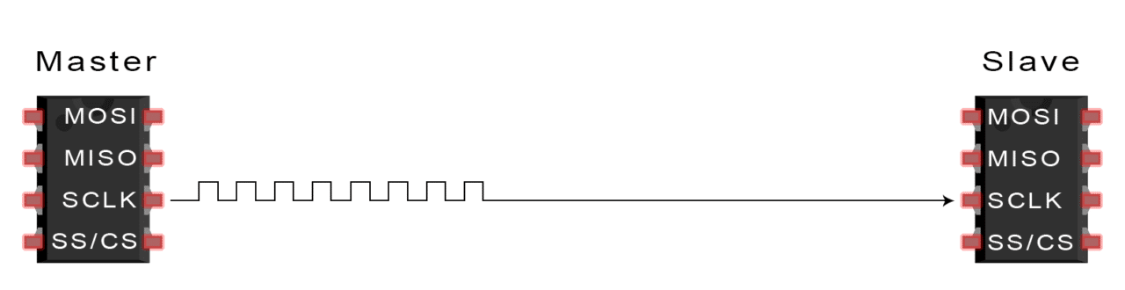
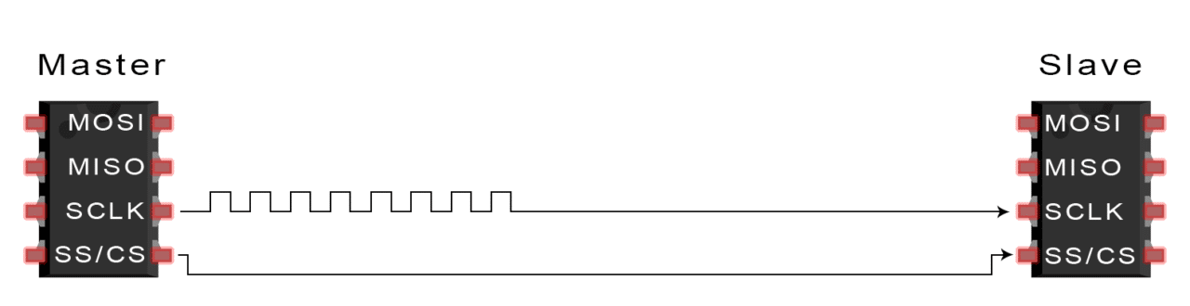
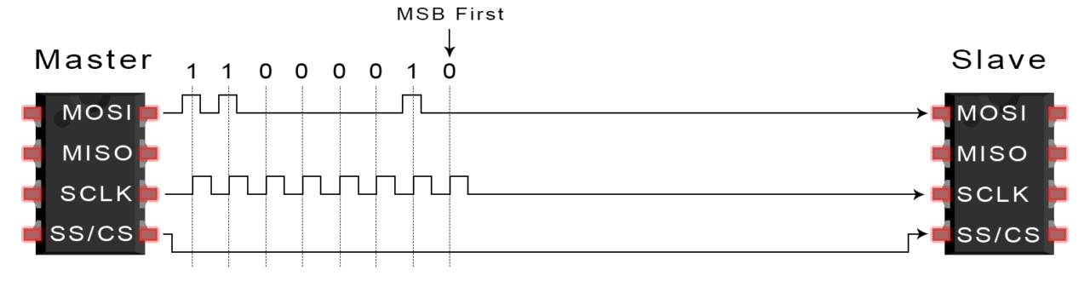
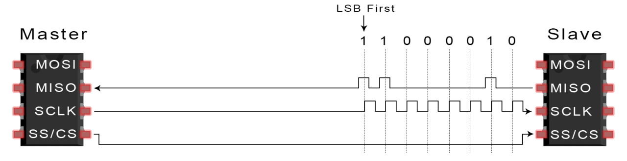
Master
Outputs Clock
Signal
Master
Switches SS/CS Low
Slave Is Activated
Master
Sends Data One Bit At A Time
Slave Reads Bits As They Are Received
Master Reads One Bit At a Time
Slave Responds Along MISO

Slide 10
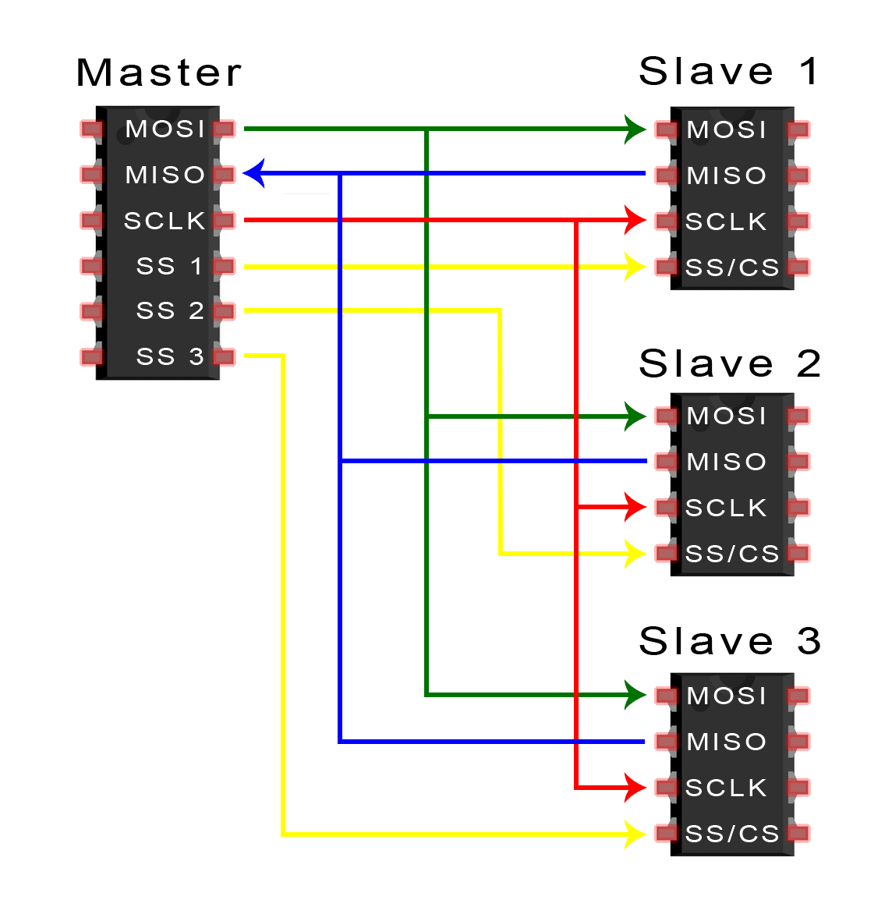
SPI
Advantages
Stream bits (unlimited frame)
High speed
Send & receive lines
Disadvantages
No error checking
No acknowledgement
Requires four wires
Single master

Slide 11
SPI
Team Alpha implemented SPI communication to their FPGA
Check out their website for Lab 4
https://cei-lab.github.io/ECE3400-2017-teamAlpha/lab4.html

Slide 12
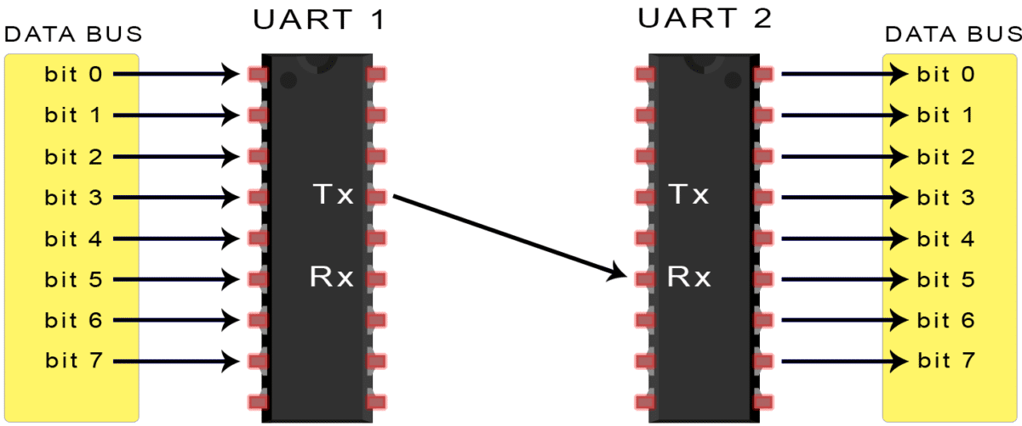
UART (Universal Asynchronous Receiver/Transmitter)

Slide 13
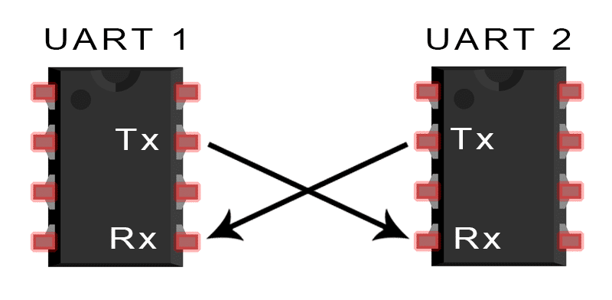
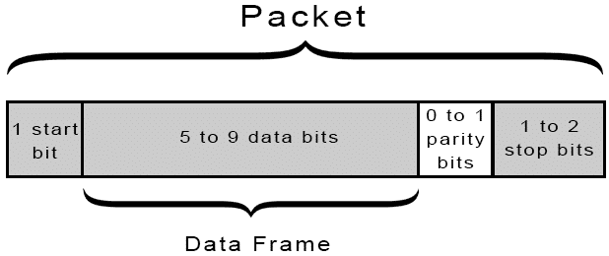
UART
A UART is a physical IC (sometimes contained as part of an MCU)
Two wire communication
Converts incoming parallel data to serial, transmits, converts back
Asynchronous
But there is an agreed upon baud rate
Start bit signals when reading begins
Use a particular “packet” format

Slide 14
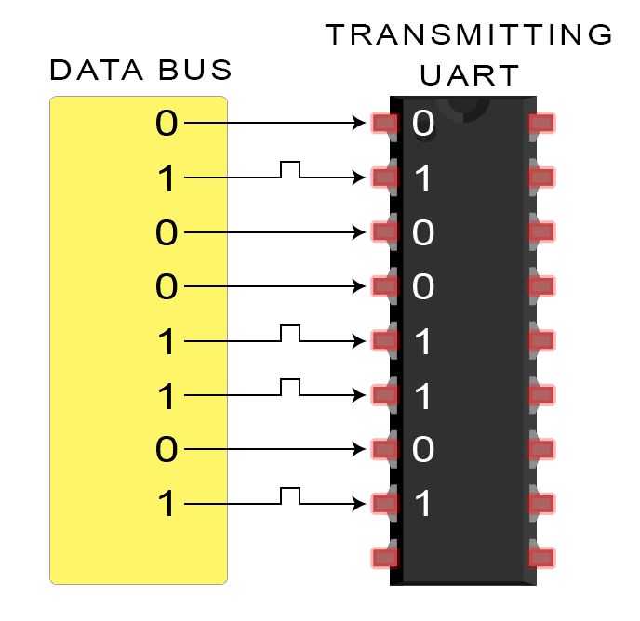
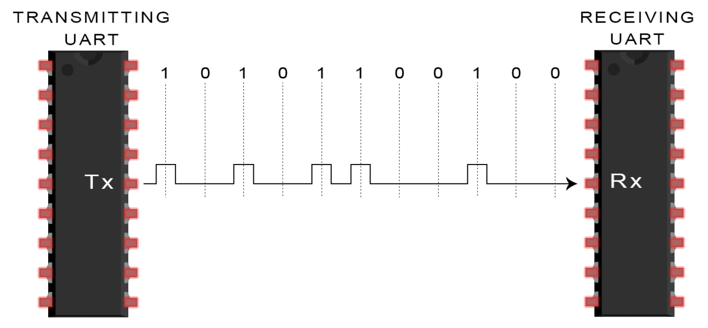
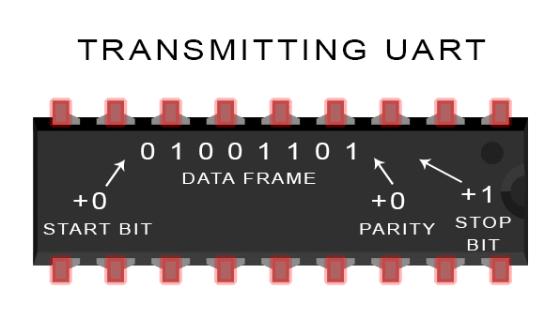
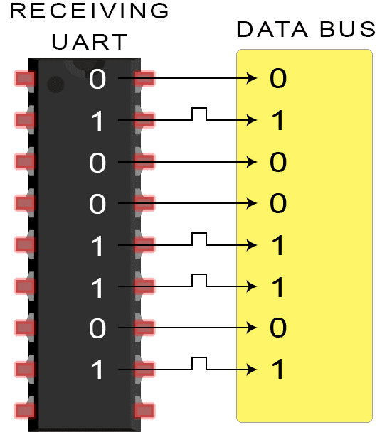
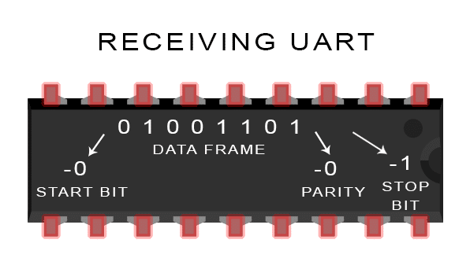

Slide 15
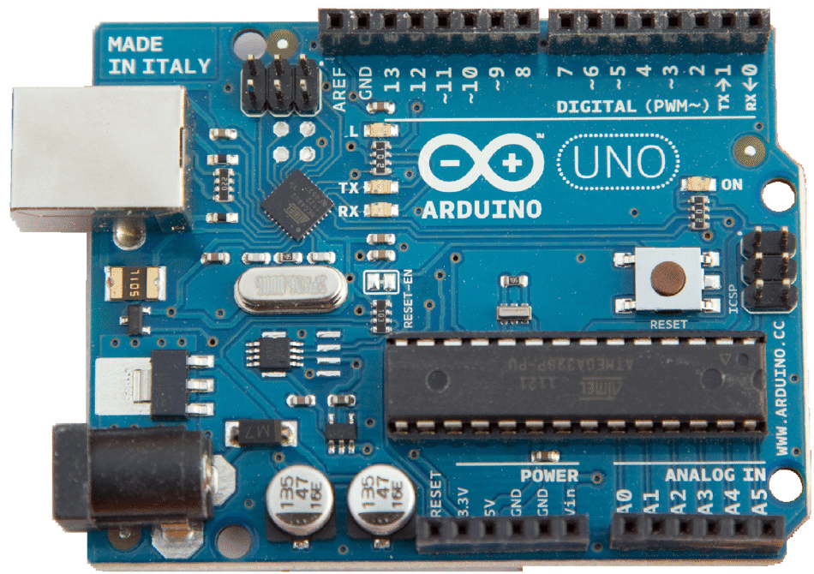
UART
Advantages
Widely used
Requires only two wires
Asynchronous
Parity bit for error checking
Disadvantages
Fixed packet size
Single Master/Slave
Baud rates must be within 10%
Commonly Used For
GPS Modules
Bluetooth Modules
RFID Card Reader Modules

Slide 16
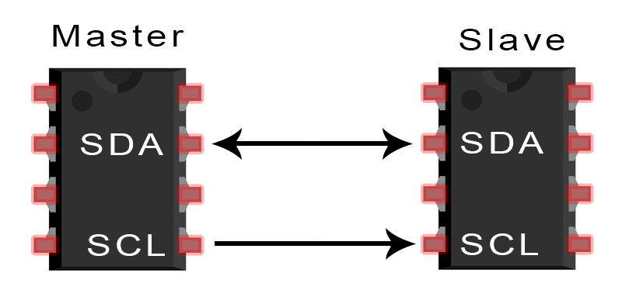
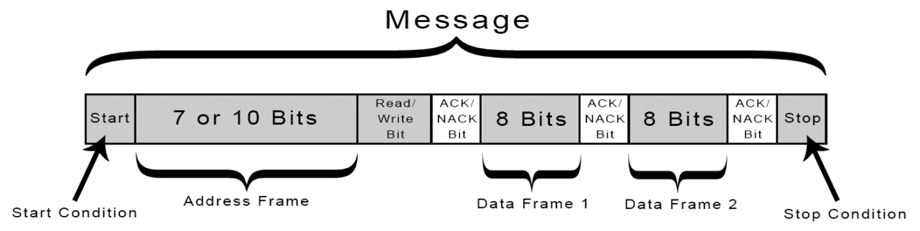
I2C (Inter Integrated Circuit)
Inter Integrated Circuit combines SPI and UART benefits
Multiple masters and multiple slaves
2 wires
Start Condition: SDA High to Low before SCL High to Low
Stop Condition: SDA Low to High after SCL High to Low

Slide 17
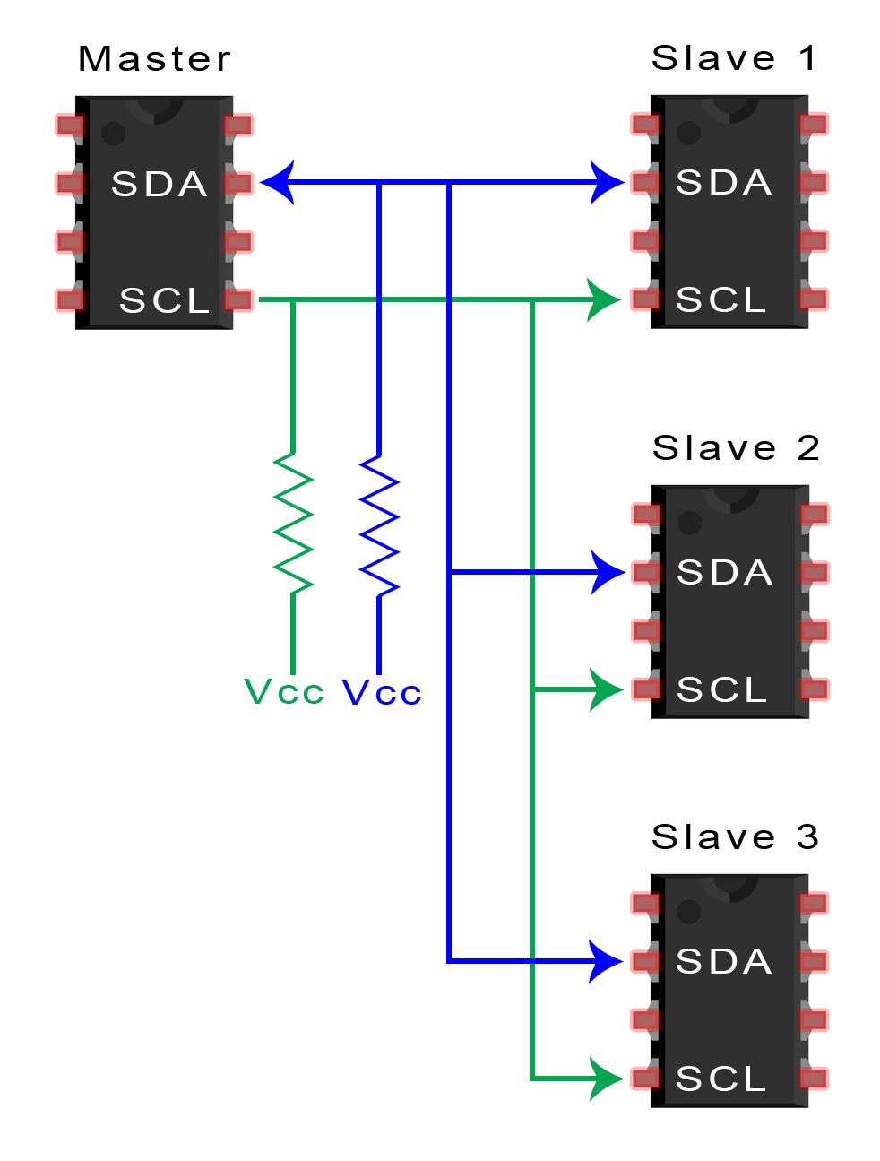
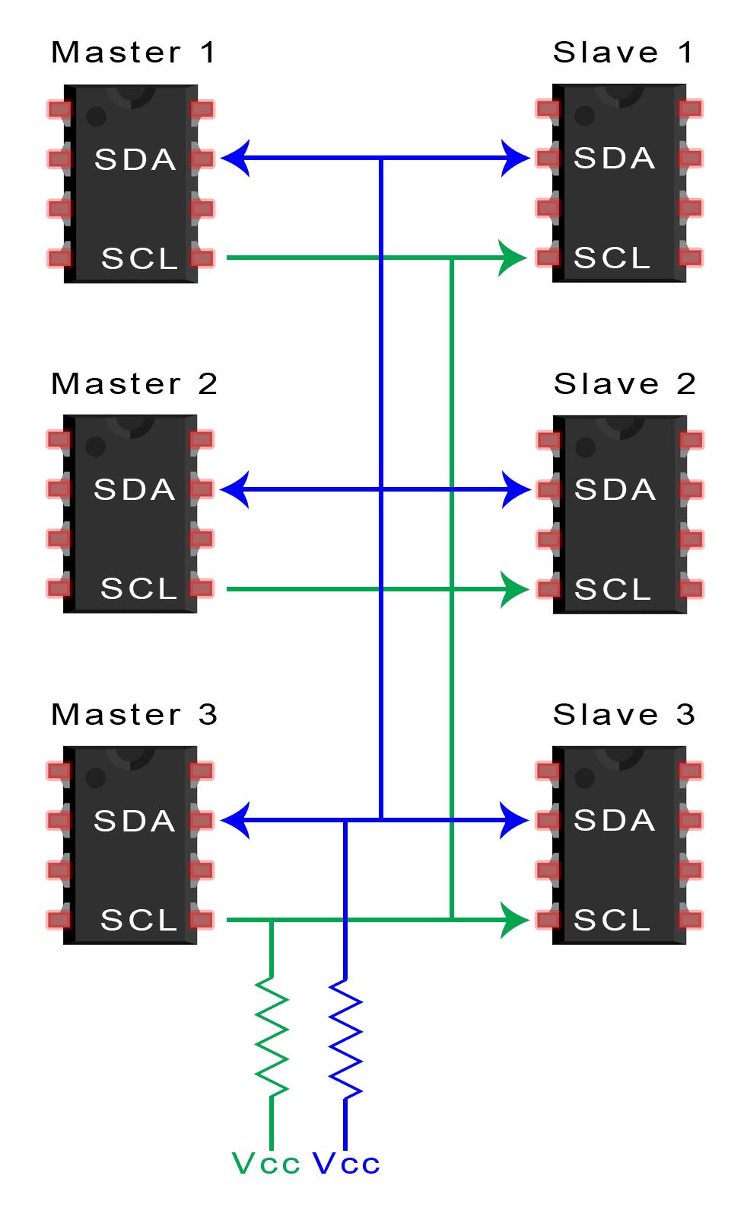
I2C Configurations

Slide 18
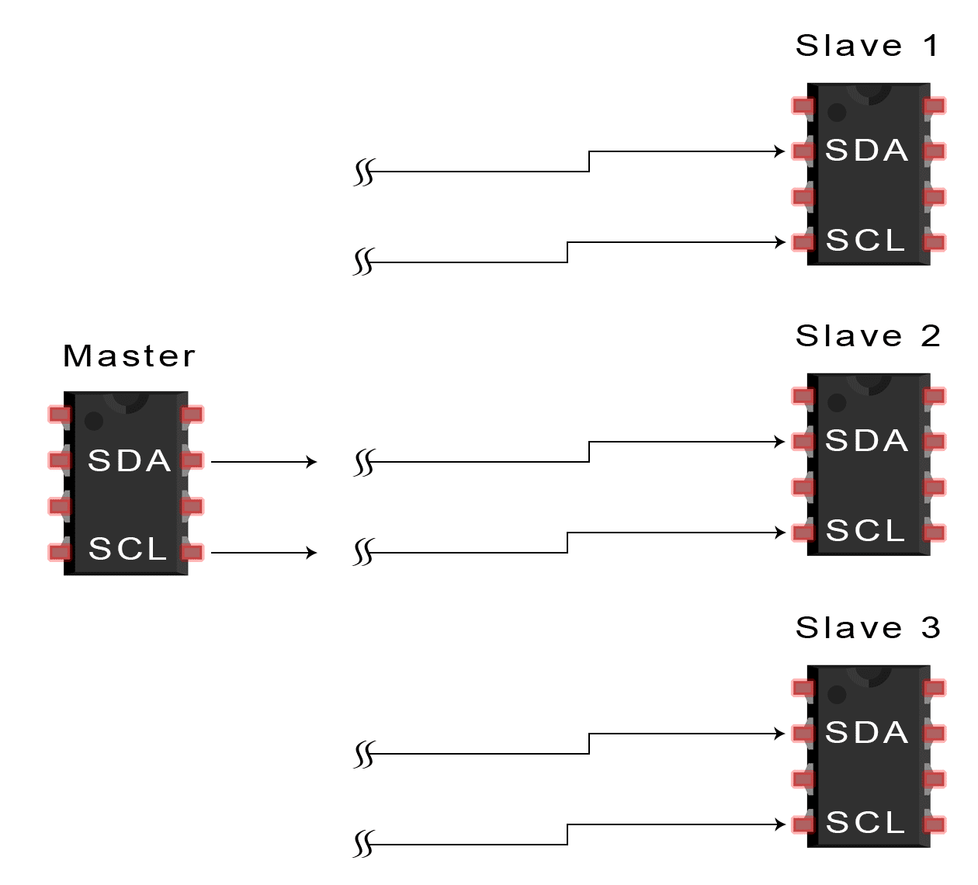
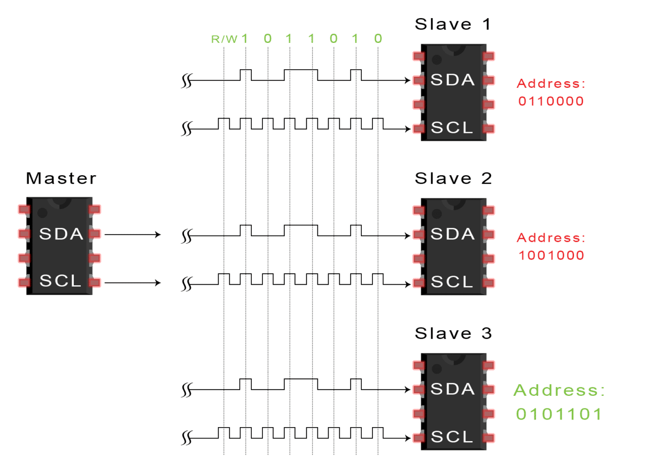
Start Condition Is Sent
Address is Sent

Slide 19
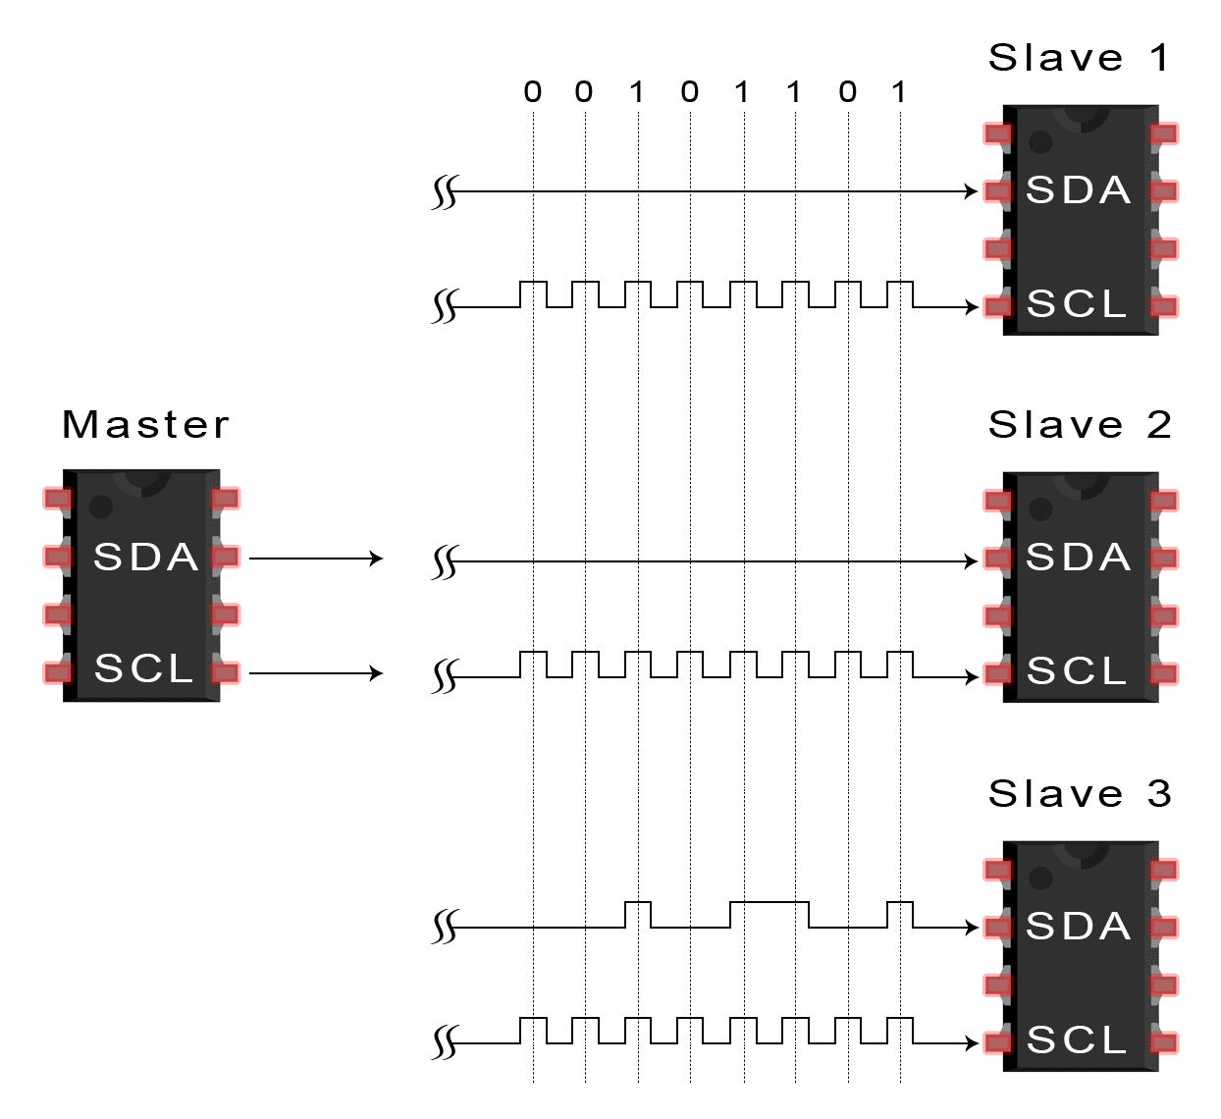
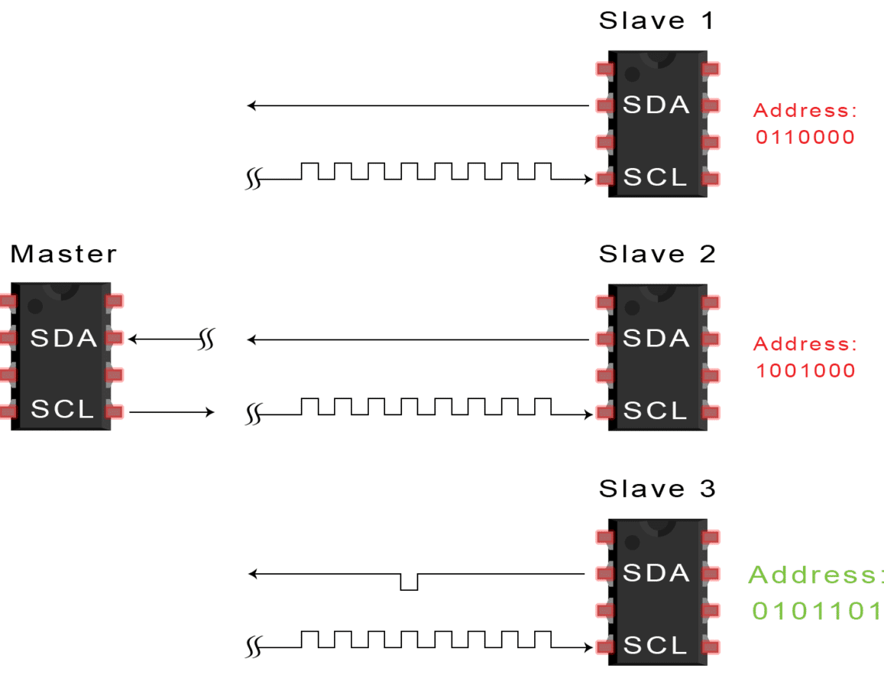
ACKnowledgement Sent
(Pull SDA Line Low)
Master Sends or Receives Data

Slide 20
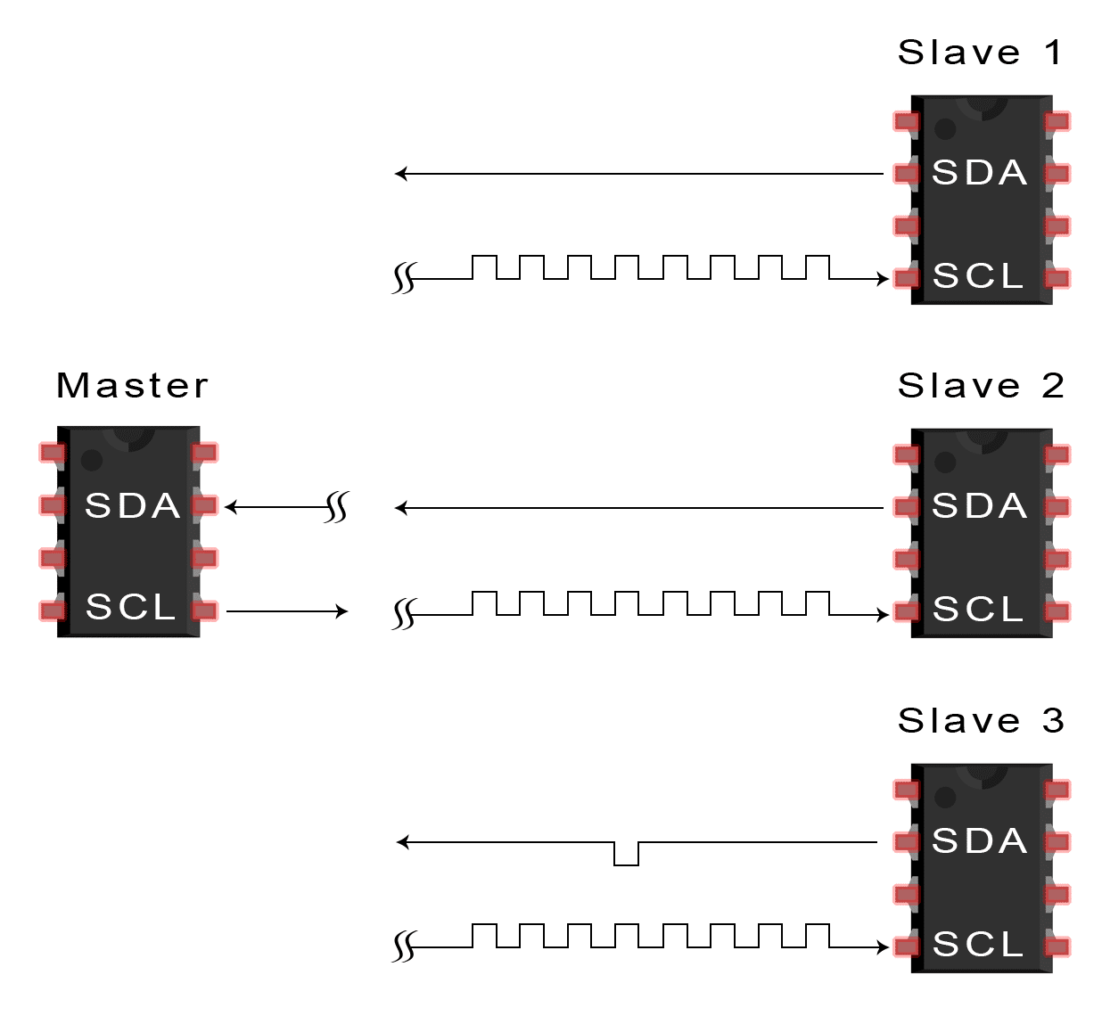
After Each Data Frame
An ACK/NACK is Sent
Master Sends Stop Condition

Slide 21
I2C
Advantages
Widely used
Requires only two wires
Ack/Nack
Multiple master/multiple slave
Disadvantages
Fixed frame size
Slower than SPI
More complicated than SPI
Commonly Used For
Sensors
Control of multiple devices
OLEDs
Accelerometers

Slide 22
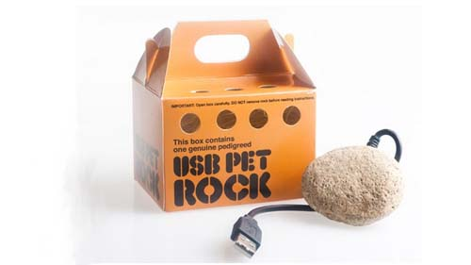
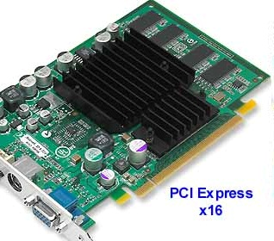
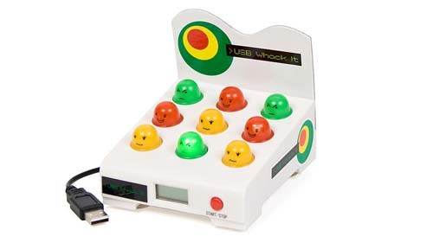

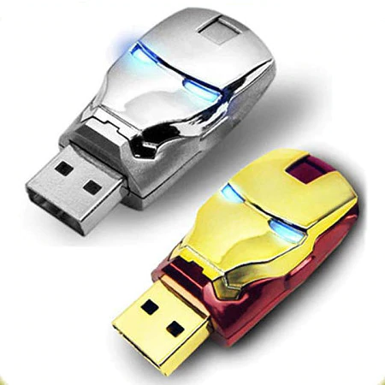
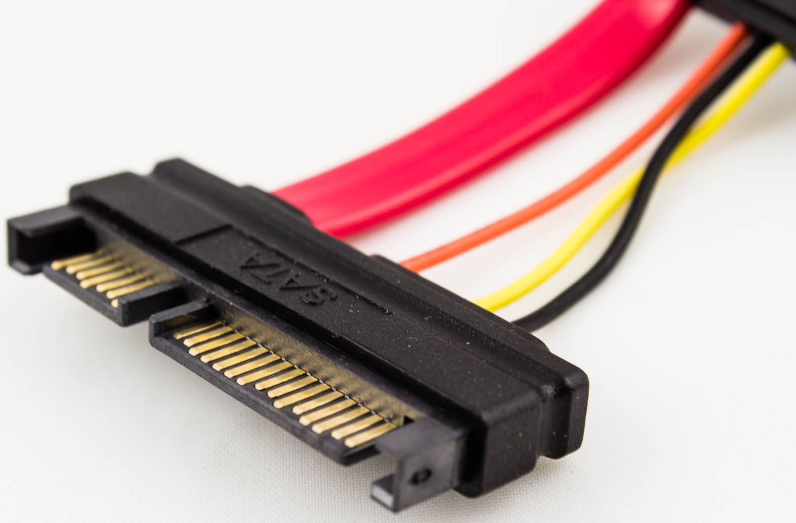
Other Serial Devices
USB ,PCIe, SATA, CAN

Slide 23
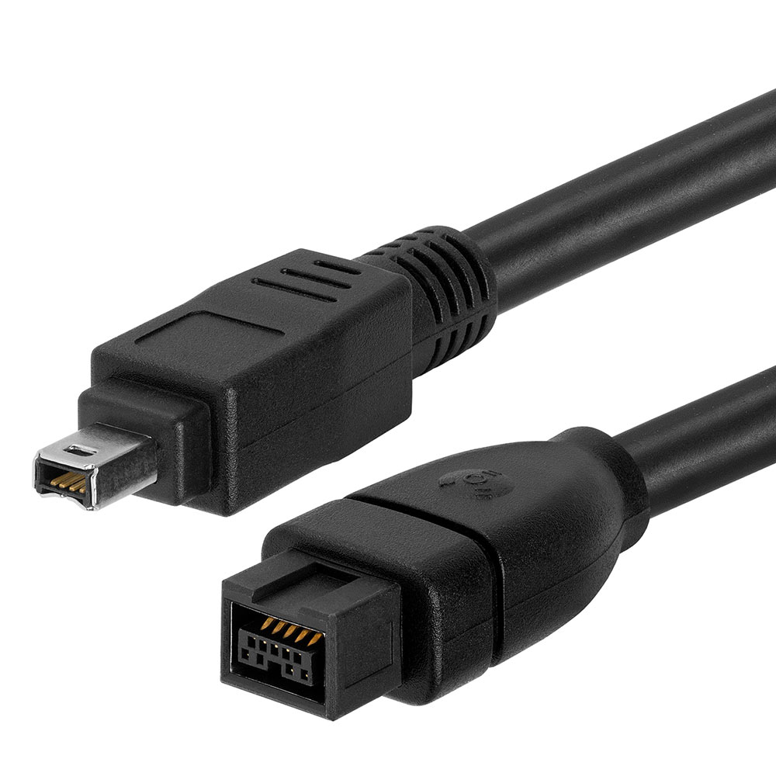
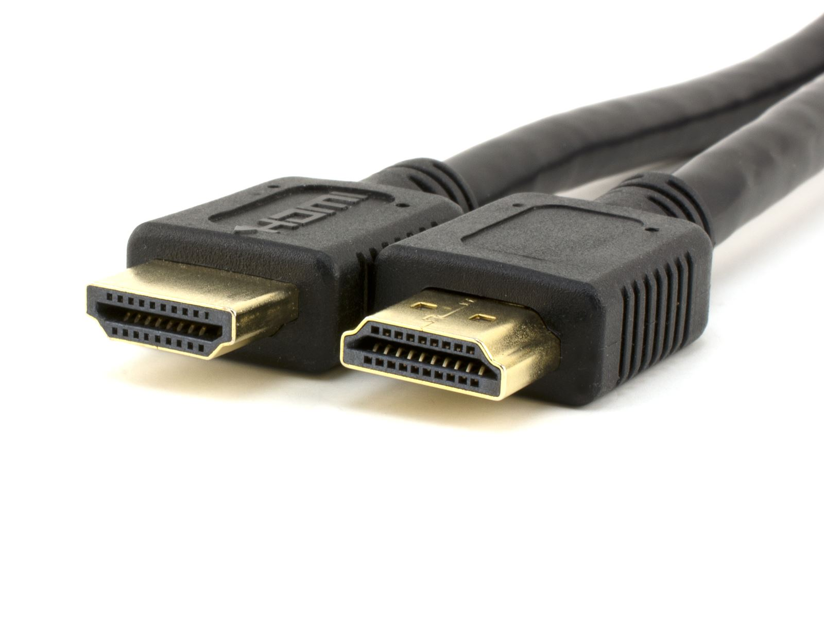
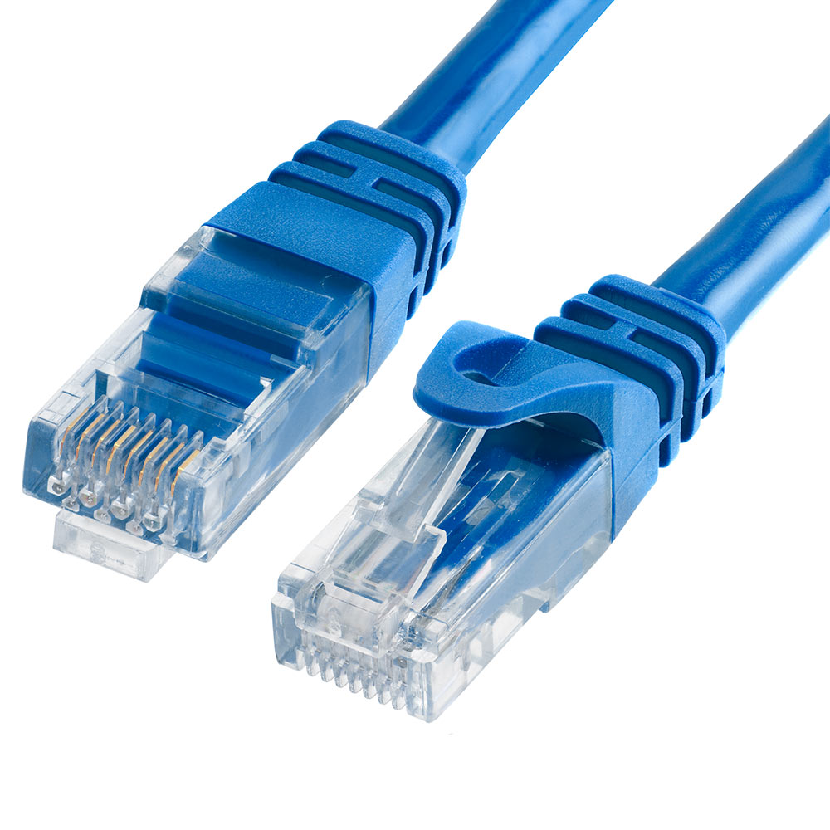
Even More Serial Devices
Ethernet, HDMI, Coax (Digital Video), Display Port, Firewire

Slide 24
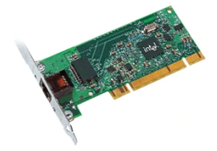
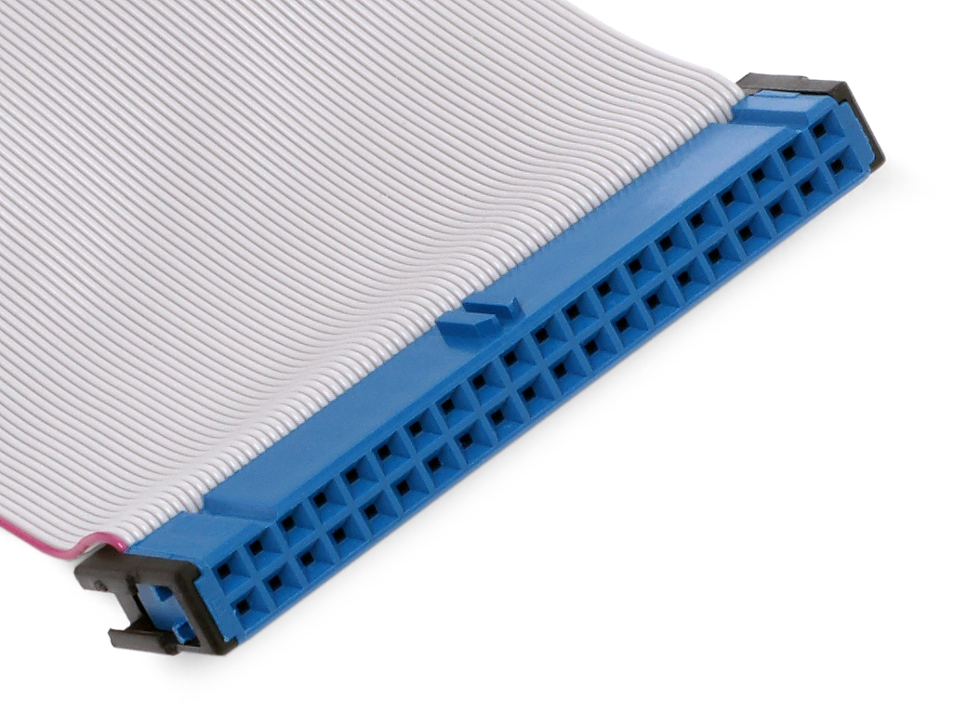
Parallel Communication
Examples are PCI, PATA
No longer favorable because of limits in speed
Cable length
Hardware complexity
However, is easy to implement on FPGA

Slide 25
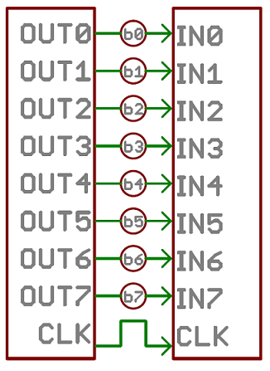
Parallel Communication & FPGAs
For example:
2-bits for message type/header
(eg. moved to new location; found treasure at square, etc.)
3-bits for message body
(eg. moved to square 4,5; square 7,7 is type wall, etc.)
1-bit for started, stopped mapping…
. and so on …
.
.

Slide 26
Parallel Communication & FPGAs
reg [2:0] grid_array [n-1:0][n-1:0];
wire [2:0] square_color;
assign square_color = GPIO_0_D[k:k-2];
…
always @ (*) begin
if (square_color == 3’d0) begin
grid_array[x][y] = square_color;
end
…
Arduino sends color directly. Reserved GPIO pins specifically for color.
Plenty of ways to implement
(pseudocode):
wire inputs [n:0];
assign inputs = GPIO_0_D[m:0];
…
always @ (*) begin
if (inputs{1:0} == 2’d3) begin
grid_array[x][y] = inputs{5:2};
end
…
Arduino sends msg header {1:0} + body {5:2} indicating color change should take place at square x,y.
msg header
msg body
Drawback: Consumes a lot of pins

Slide 27
Choosing a Protocol
Heavily dependent on what type of robot you want to build
Considerations
Cost
Usable wire length
Device pin count
Speed
Etc.
You can also make your own communication protocol!

Slide 28
References
Much of this presentation material is based on material discussed in www.circuitbasics.com
SPI, UART, & I2C
Sparkfun also has excellent discussions on these topics

